Slide 1
CSE 12 – Basic Data Structures and Object-Oriented Design Lecture 14
Greg Miranda and Paul Cao, Winter 2021
This lecture is being recorded

Slide 2
Announcements
Quiz 14 due Wednesday @ 8am
PA5 due Wednesday @ 11:59pm
Survey 6 due Friday @ 11:59pm

Slide 3
Topics
Sorting Wrap-up
Questions on Lecture 14?

Slide 4
Questions on Lecture 14?

Slide 5
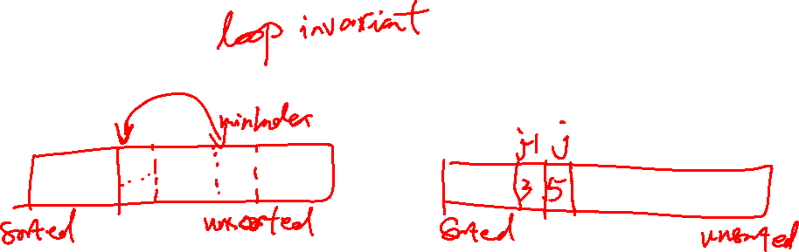
import java.util.Arrays;
public class Sort {
static void selectionSort(int[] arr) {
for(int i = 0; i < arr.length; i += 1) {
int minIndex = i;
for(int j = i; j < arr.length; j += 1) {
if(arr[minIndex] > arr[j]) { minIndex = j; }
}
int temp = arr[i];
arr[i] = arr[minIndex];
arr[minIndex] = temp;
}
}
static void insertionSort(int[] arr) {
for(int i = 0; i < arr.length; i += 1) {
for(int j = i; j > 0; j -= 1) {
if(arr[j] < arr[j-1]) {
int temp = arr[j-1];
arr[j-1] = arr[j];
arr[j] = temp;
}
else { break; } // new! exit inner loop early
}
}
}
}

Slide 6
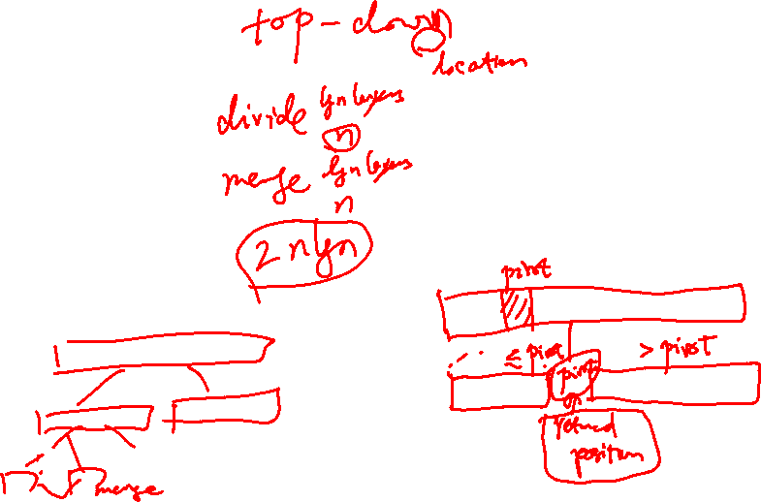
import java.util.Arrays;
public class SortFaster {
static int[] combine(int[] p1, int[] p2) {...}
static int[] mergeSort(int[] arr) {
int len = arr.length
if(len <= 1) { return arr; }
else {
int[] p1 = Arrays.copyOfRange(arr, 0, len / 2);
int[] p2= Arrays.copyOfRange(arr, len / 2, len);
int[] sortedPart1 = mergeSort(p1);
int[] sortedPart2 = mergeSort(p2);
int[] sorted = combine(sortedPart1, sortedPart2);
return sorted;
}
}
static int partition(String[] array, int l, int h) {...}
static void qsort(String[] array, int low, int high) {
if(high - low <= 1) { return; }
int splitAt = partition(array, low, high);
qsort(array, low, splitAt);
qsort(array, splitAt + 1, high);
}
public static void sort(String[] array) {
qsort(array, 0, array.length);
}
}

Slide 7
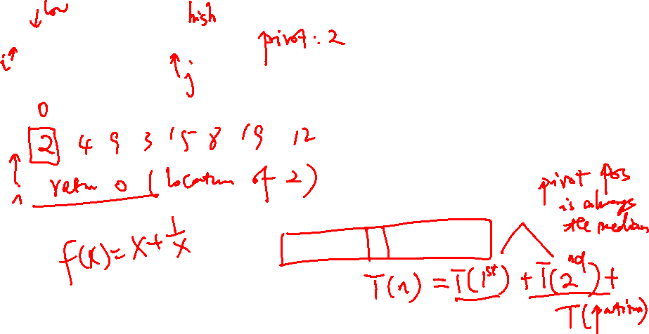
Quick sort
Quicksort(Arr, low, high)
if (low < high)
pivotPos = partition(Arr, low, high)
Quicksort(Arr, low, pivotPos – 1)
Quicksort(Arr, pivotPos + 1, high)
sort {12, 4, 9, 3, 15, 8, 19, 2}
partition(Arr, low, high)
pivot = Arr[high]
i = low – 1
for (j = low; j < high, j++){
if (Arr[j] < pivot)
i++
swap(A[i], A[j])
swap(A[i+1], A[high])
return i + 1

Slide 8
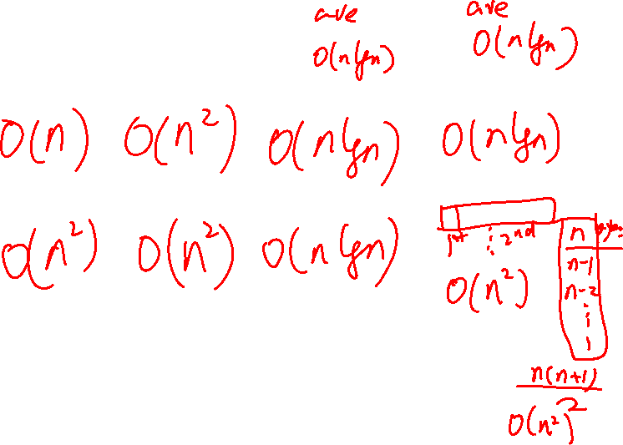
 | Insertion | Selection | Merge | Quick
Best case time
Worst case time
Key operations | swap(a, j, j-1) (until in the right place) | swap(a, i, indexOfMin) (after finding minimum value) | l = copy(a, 0, len/2) r = copy(a, len/2, len) ls = sort(l) rs = sort(r) merge(ls, rs) | p = partition(a, l, h) sort(a, l, p) sort(a, p + 1, h)

Slide 9
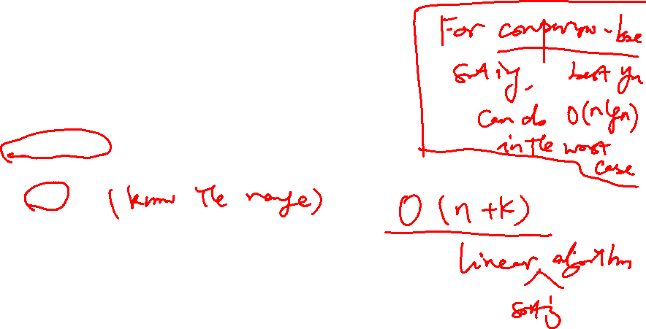
Non-comparison based sorting
Normally it is for integer sorting
Count sort
Assume that we have n positive integers and we know that all of them are <=k

Slide 10
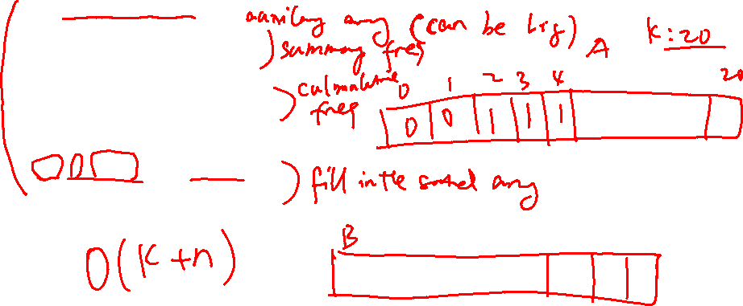
Count sort (A, B, k):
let C[0,...,k] be a new array and initialized to be 0
for j = 1 to A.length
C[A[j]]++
for i = 1 to k
C[i] = C[i] + C[i-1]
for j = A.length down to 1
B[C[A[j]]] = A[j]
C[A[j]] = C[A[j]] - 1
Example {12, 4, 9, 3, 15, 8, 19, 2}

Slide 11
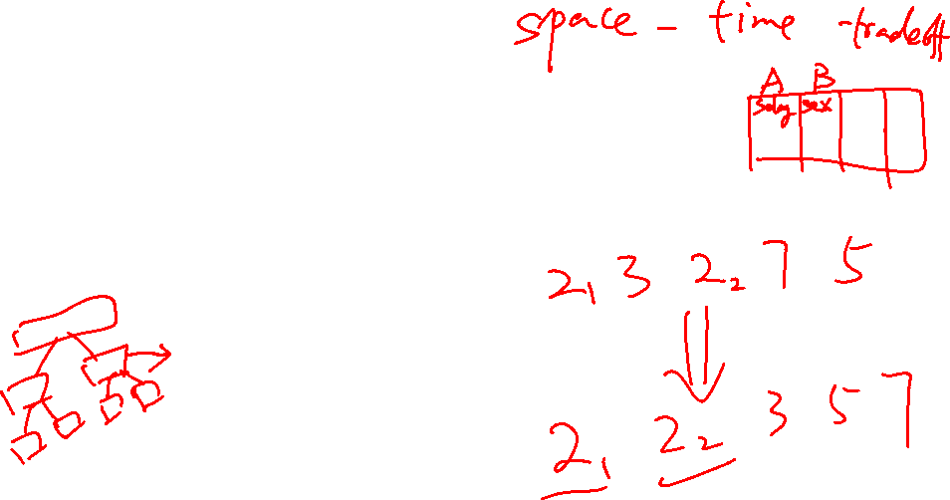
Last note about sorting
Not only do we care about runtime, we also care about
Space: do we need extra storage?
stable: if we have duplicates, do we maintain the same ordering?
Algorithm | Space | Stable
Bubble sort | O(1) | Yes
Selection sort | O(1) | No
Insertion sort | O(1) | Yes
Heap sort | O(1) | No
Merge sort | O(n) | Yes
Quick sort | O(logn) | No
Count sort | O(n+k) | Yes

Slide 12
Array Sorting Algorithms (wiki)
Algorithm | Time Complexity
 | Best | Average | Worst
Quicksort | Ω(n log(n)) | Θ(n log(n)) | O(n^2)
Mergesort | Ω(n log(n)) | Θ(n log(n)) | O(n log(n))
Timsort | Ω(n) | Θ(n log(n)) | O(n log(n))
Heapsort | Ω(n log(n)) | Θ(n log(n)) | O(n log(n))
Bubble Sort | Ω(n) | Θ(n^2) | O(n^2)
Insertion Sort | Ω(n) | Θ(n^2) | O(n^2)
Selection Sort | Ω(n^2) | Θ(n^2) | O(n^2)
Tree Sort | Ω(n log(n)) | Θ(n log(n)) | O(n^2)
Shell Sort | Ω(n log(n)) | Θ(n(log(n))^2) | O(n(log(n))^2)
Bucket Sort | Ω(n+k) | Θ(n+k) | O(n^2)
Radix Sort | Ω(nk) | Θ(nk) | O(nk)
Counting Sort | Ω(n+k) | Θ(n+k) | O(n+k)
Cubesort | Ω(n) | Θ(n log(n)) | O(n log(n))

